Slide 1
The Discrete Event Simulation Approach (II) Chapter 7

Slide 2
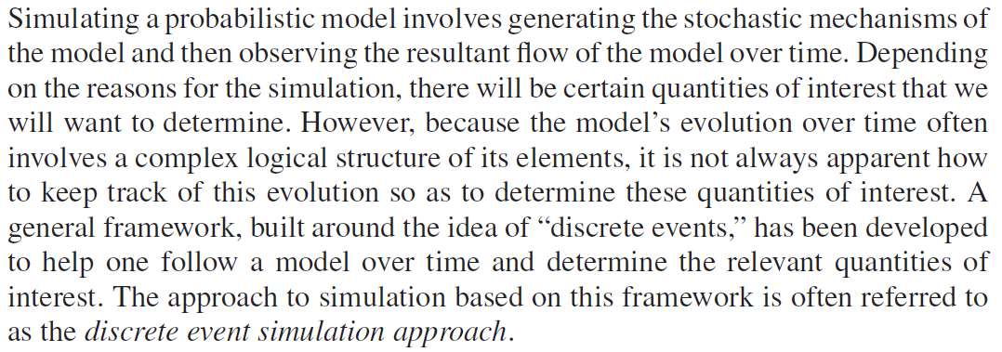

Slide 3
Agenda
7.1 Simulation via Discrete Events
7.2 A Single-Server Queueing System
7.3 Queueing System with Two Servers in Series
7.4 Queueing System with Two Parallel Servers
7.5 An Inventory Model
7.6 An Insurance Risk Model
7.7 A Repair Problem
7.8 Exercising a Stock Option
7.9 Verification of the Simulation Model

Slide 4
7.3 Queueing System with Two Servers in Series

Slide 5
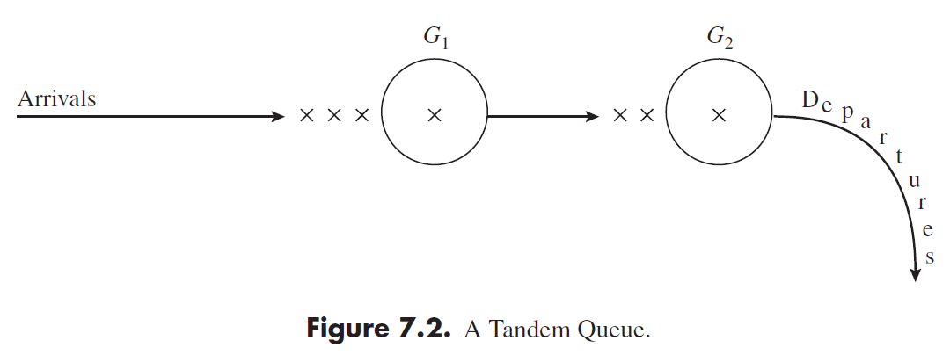

Slide 6
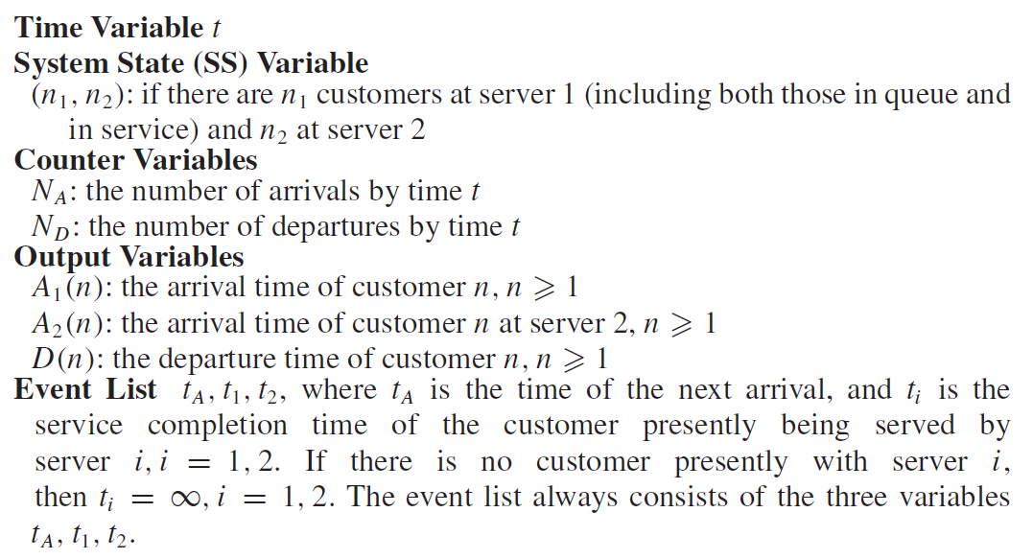
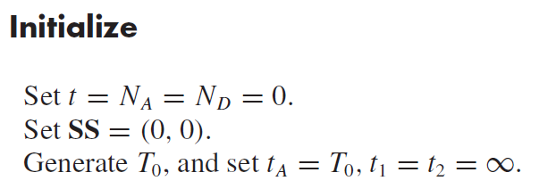

Slide 7
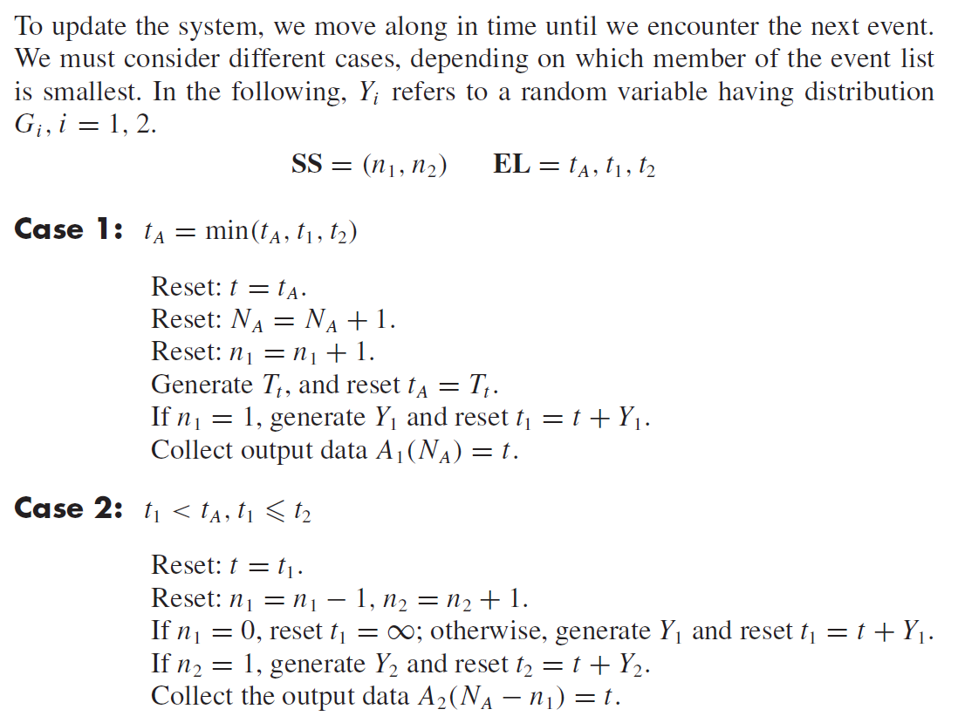

Slide 9
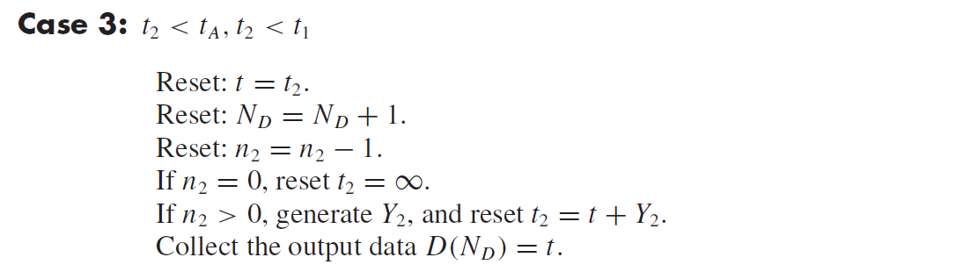

Slide 10
7.4 Queueing System with Two Parallel Servers

Slide 11
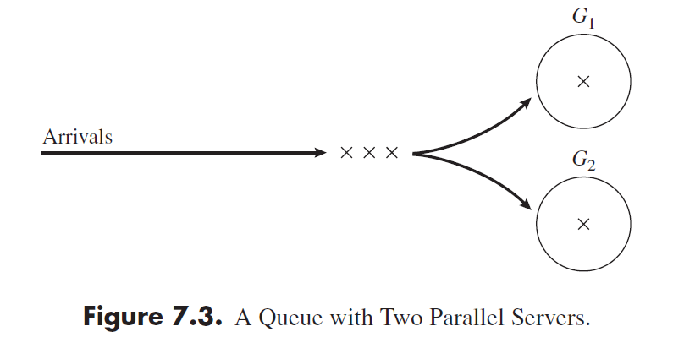

Slide 12
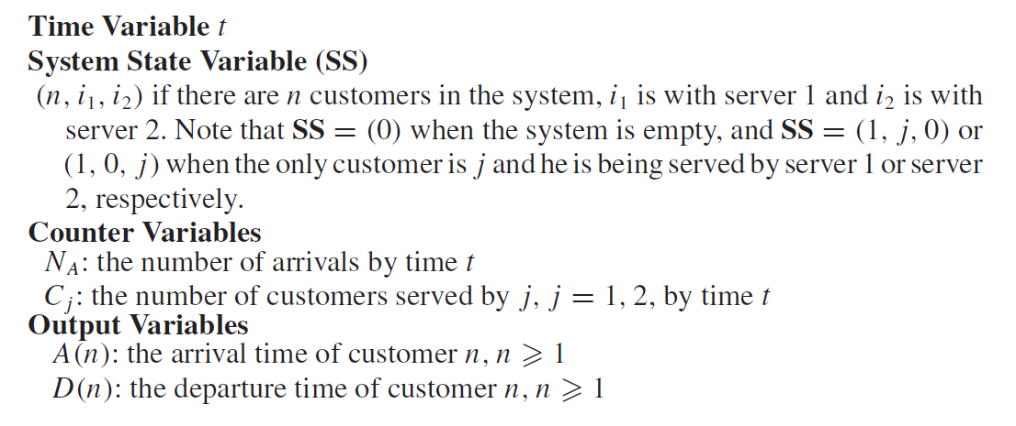
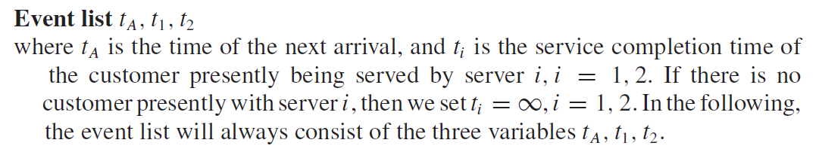
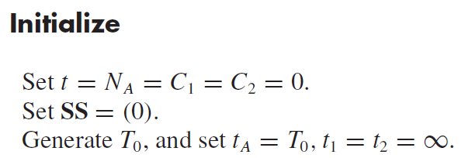

Slide 13
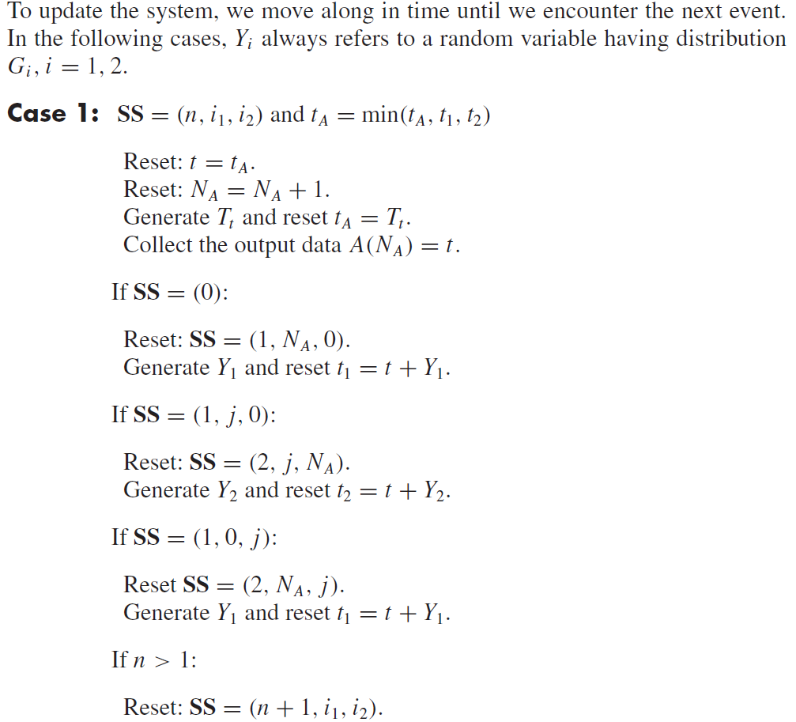

Slide 14
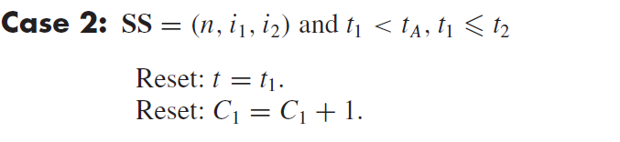
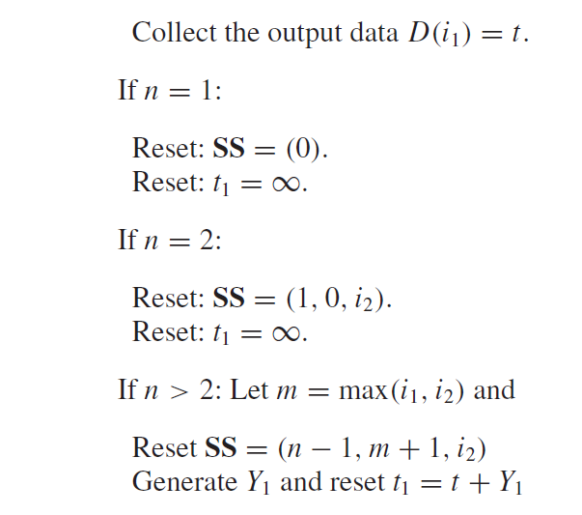
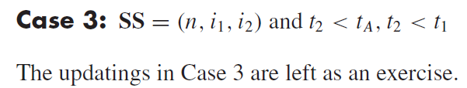

Slide 15
7.5 Inventory Model

Slide 16
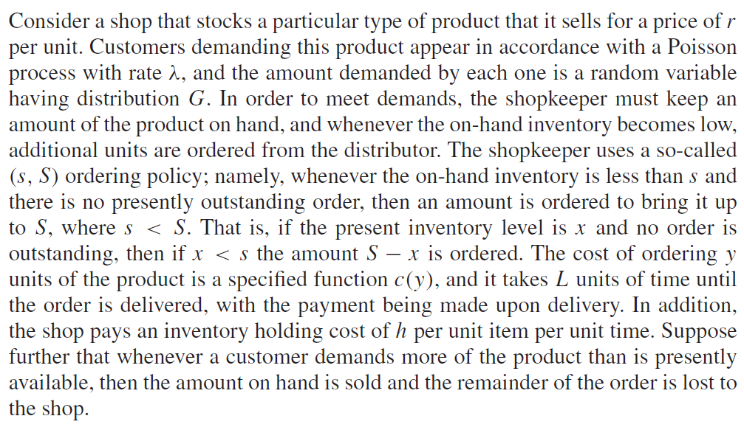

Slide 17
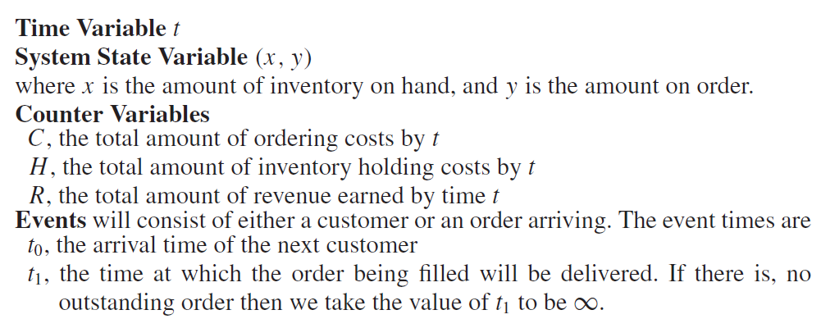

Slide 18
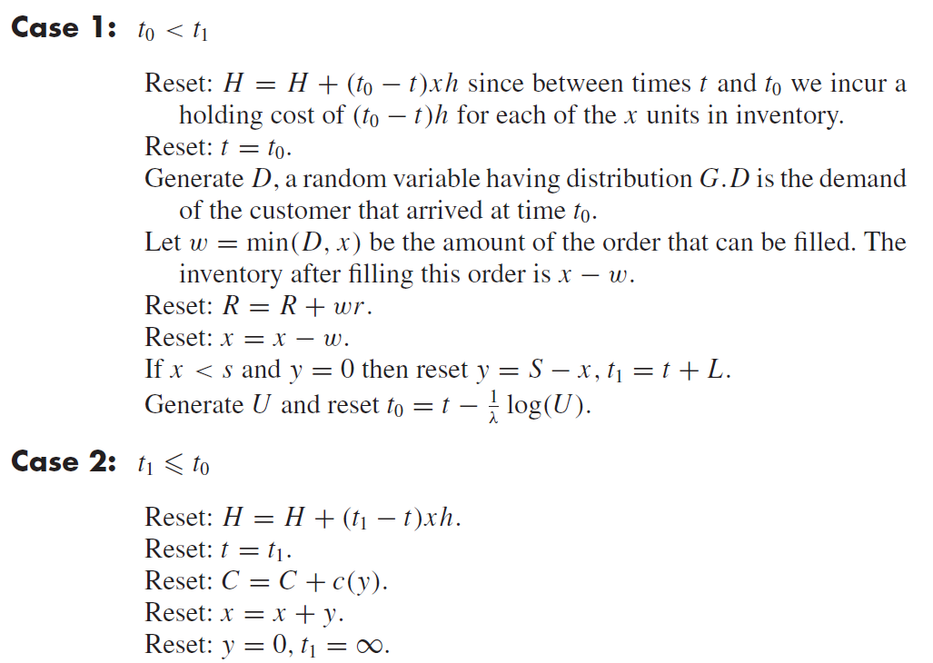

Slide 19
7.6 An Insurance Risk Model

Slide 20
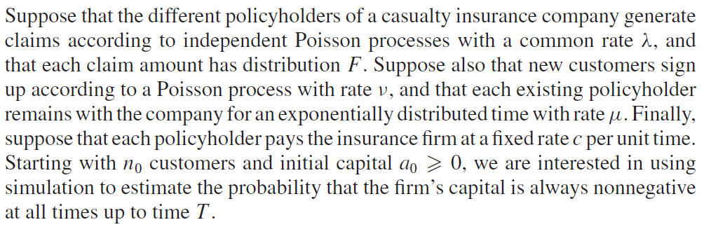

Slide 21
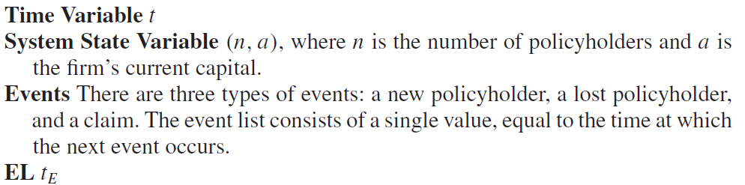

Slide 22
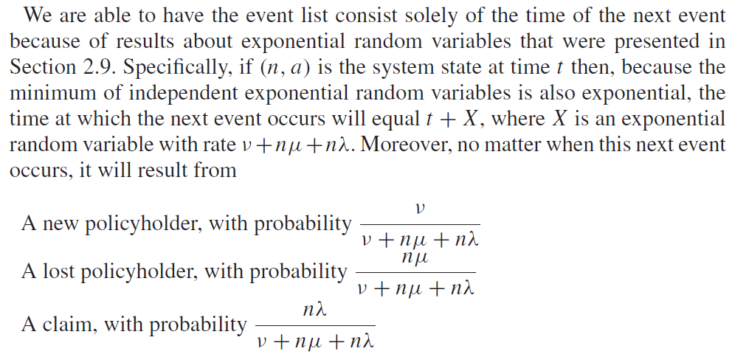

Slide 23
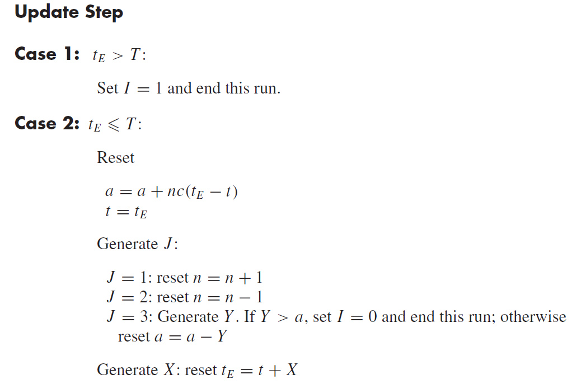

Slide 24
7.7 Repair model

Slide 25
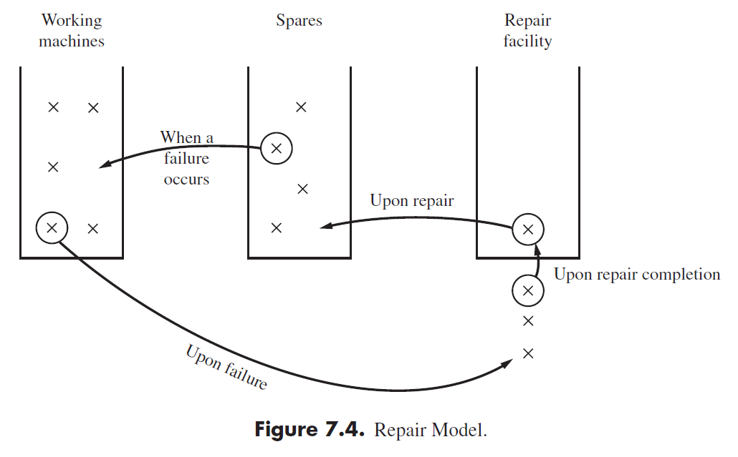

Slide 26
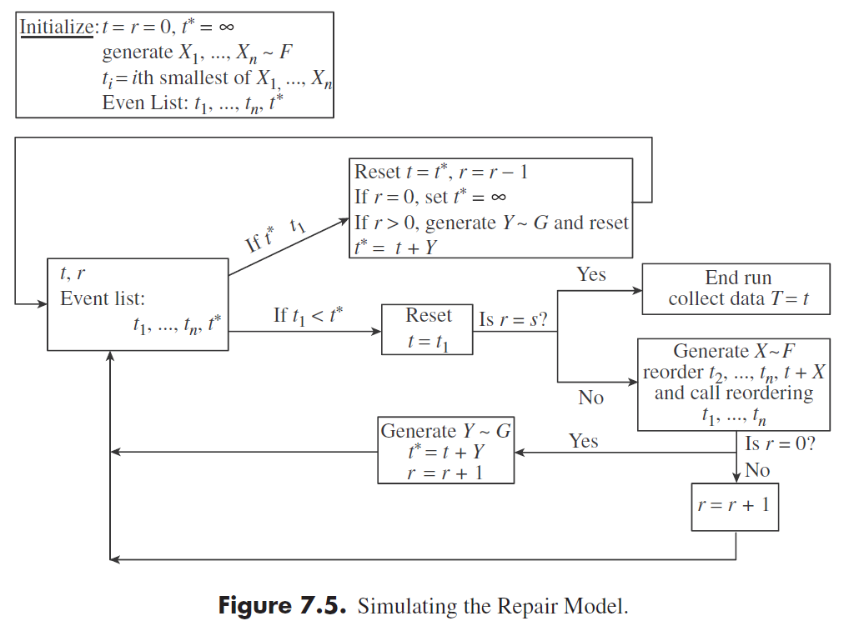

Slide 27
7.9 Verification of the Simulation Model

